Slide 1

Case study 1 for team 3

Slide 2
PART 01
Hypothesis
PART 02
Clustering
Content
PART 03
Exploration analysis
PART 04
Marketing strategies

Slide 3
Hypothesis
What user behavior are we most concerned about?
User's trading behavior: What is the frequency of transactions? What is the volume of transactions?etc
Determine the profit generated by users
Hypothesis
Profit and user loyalty related features are key in distinguishing our users
Cluster customers and proceed with further analysis.
User’s Software Usage Behavior: Do they frequently use the software? What actions do they undertake?
Determine user loyalty

Slide 4
Hypothesis
Profit
What we want to find?
User info based
Trade based
Account set up time (KYC)
Source of wealth
Employment statues
Acquisition source
01
02
Money amount (Trading, Deposit and Withdrawal)
Frequency (Trading, Deposit, Withdrawal)
Churn
We want to cluster users based on their loyalty and the profits they bring.
Analyze the behavior of users in different clusters and give different market strategies.
User data
Loyalty
Investment based
04
03
Segment based
User’s preferences based on the areas in which the user invests (symbol)
Session (Event, Count and time)
Screen and tap (Event and frequency)

Slide 5
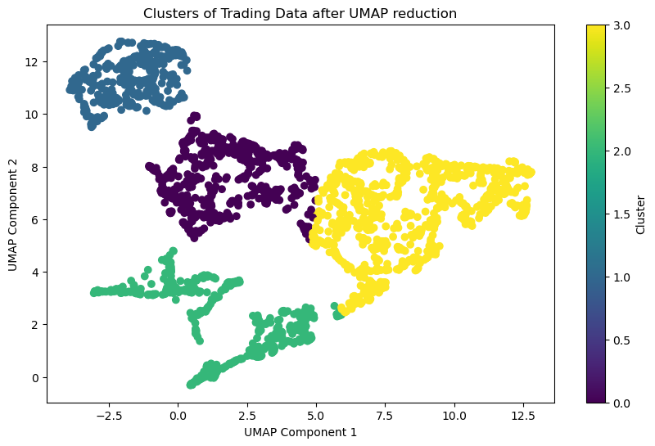
Clustering Features
01
Trading features
Number of trading
Deposit (Average deposit amount)
Buy (Average purchase amount）
Trading frequency
02
Loyalty features
Account set up time (KYC started and account opened at)
Churn percentage (The ratio of is_churn to account existing day)
Number of session
Screen and tap point (screen segment and tap segment)

Slide 6
Clustering result
Group 1:
High value trading users
（718 (26.6%)）
Group 2:
Stable trading users
787 (29.1%)
Highest trading volumes
Highest operation time
Loyalty
High trading frequency
Low trading volumes
Lowest churn percentage
Low operation time
Group 3:
Less active trading users
336 (12.4%)
Group 4:
Dormant Users
466 (17.3%)
Lowest trading frequency
Lowest trading volumes
Group 5:
Only buy users
High trading volumes
Highest churn percentage
Group 6:
No trading users
Profit
393(14.6%)

Slide 7
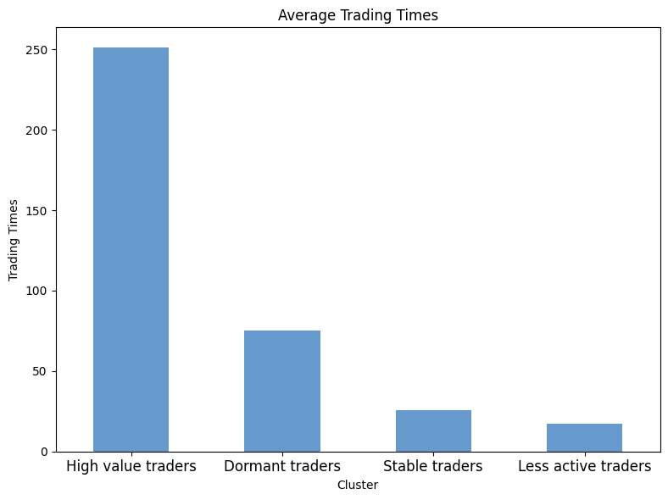
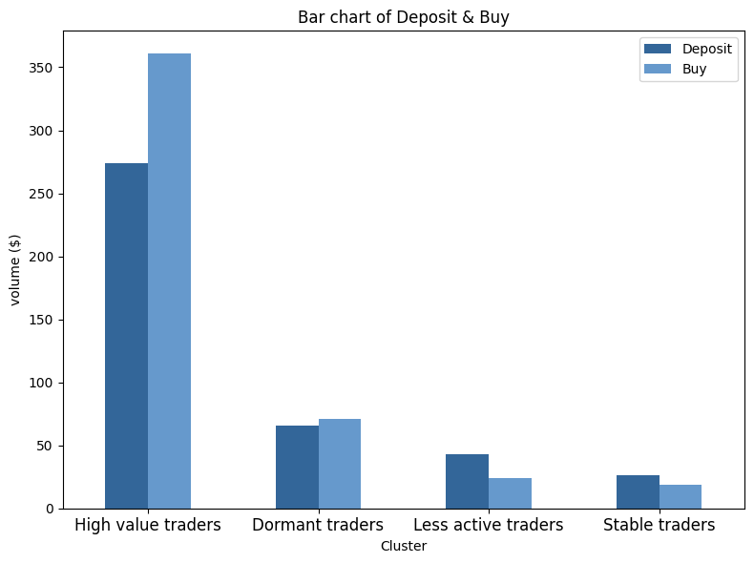
Analysis based on company’s profit
Observation:
Users in high value trading group have the highest trading volume. Users in this group not only have the largest average trading times, they also like to deposit a large amount of funds into their account each time and make large stock trades.
Less active trading users and Stable trading users have the lowest trading volume.

Slide 8
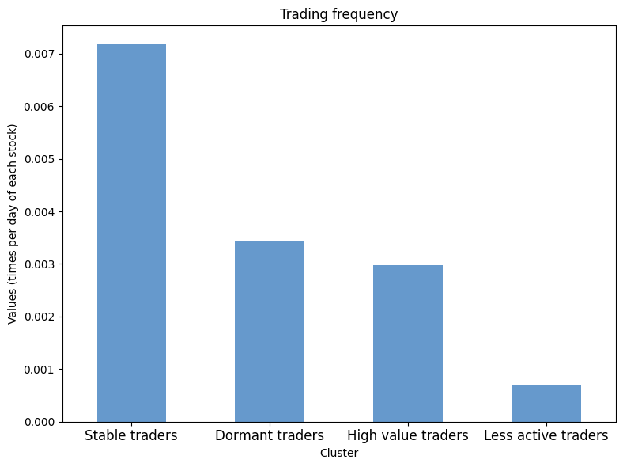
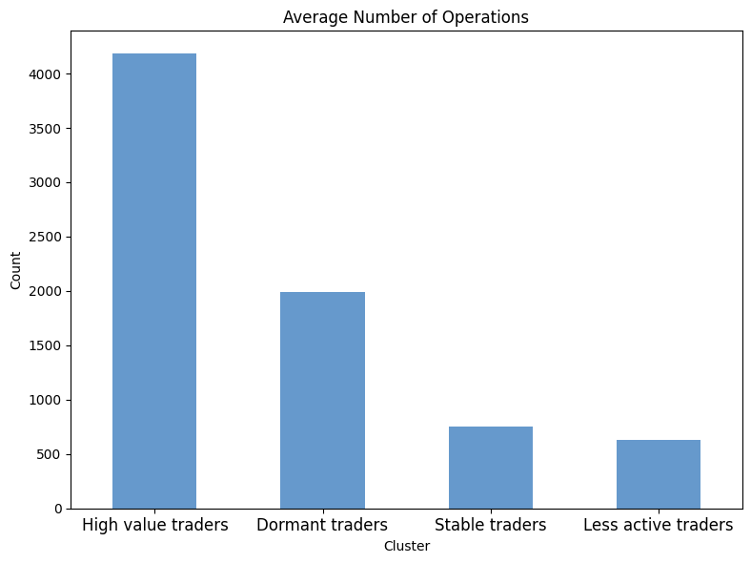
Analysis based on user loyalty
Observation:
Stable traders have the largest trading frequency. Although they have smaller investments (shown in chart on the previous page), they have always remained active. This means they are more loyal to the software and are more likely to continue using it in the future.
High value traders have the largest number of operations, while stable traders and less active trading users have low operation time.
Less active trading users have the minimum trading frequency and number of operations. It can be concluded that this type of users have low loyalty to the software.

Slide 9
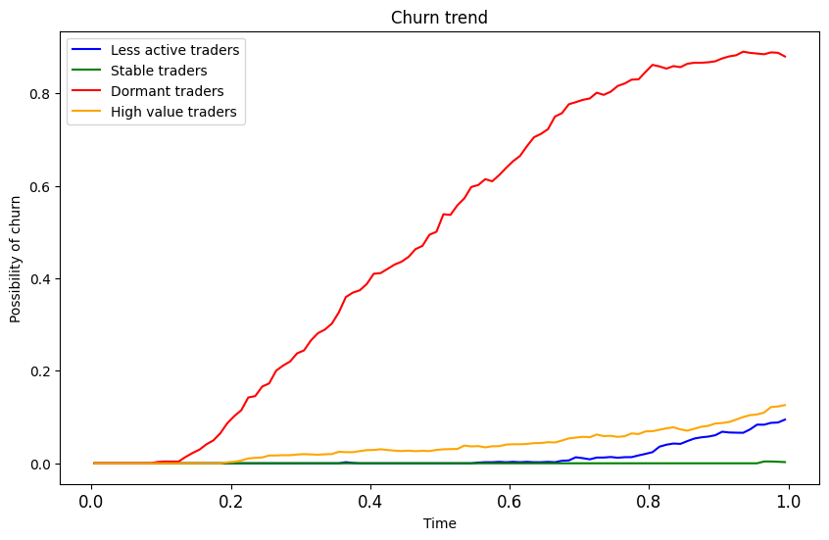
Analysis based on user loyalty
Observation:
Dormant users have the highest churn percentage. They are the users who withdraw all of the funds from the account at a certain point and stop using the software. We can see from the line chart that this type of users has an obvious churn trend, while other groups of users at least maintain a certain interest and keep their funds in their account.
Dormant users used to bring some profits to the company. so we want to get them back trading on our platform.

Slide 10
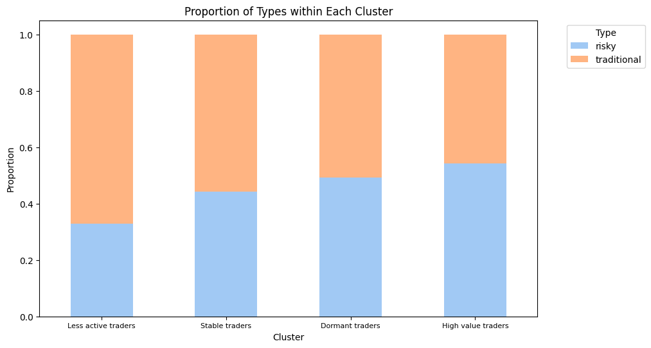
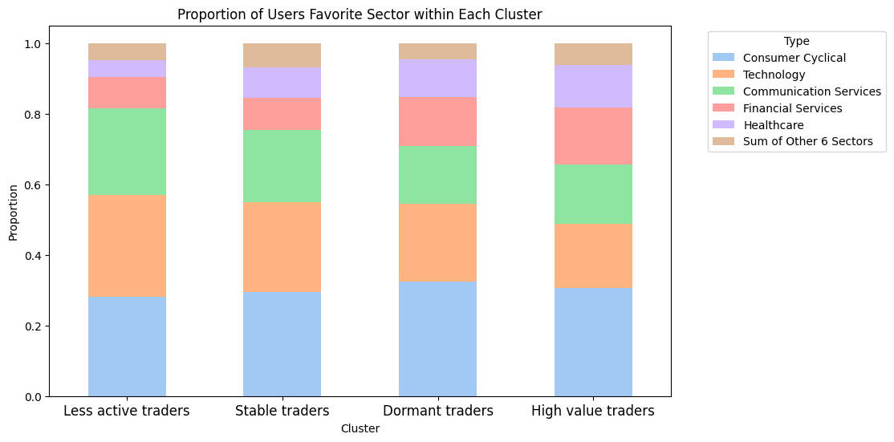
Other interesting observations
Observation:
Different group of users have different level of risk tolerance. Less active traders have the lowest level of risk tolerance while high value traders have the highest level of risk tolerance
Different group of users have different investment preferences. However, Consumer Cyclical, Technology and Communication Services are the top 3 sectors which interests all groups of users.
Data Sources: https://finance.yahoo.com/ , https://stockanalysis.com/

Slide 11
Marketing strategies
1. High trading volumes
Set the monthly goals of trading values.
Once they have achieved the goals, we can offer them products with less fees.
Encourage them to achieve the goals, instead of relying entirely on their own willing to trade and keep high trading.
Low trading frequency
Offer trading rewards
High value trading users
2. High average trading time
Since average trading times is high, the accuracy for recommendation may be outstanding, so we apply more calculation.
Recommend products in best preference sector.
Providing personal recommendation can help remaining their high trading frequency.
Low trading frequency
Recommend the product according to their preference.
Highest trading volumes
Highest operation time
3. High operation time
Everyone can communicate, share investment experiences and ideas.
Increase interaction with the GoTrade.
Professional ideas from high value trading users may interact new users.
Build a community

Slide 12
Marketing strategies
1. Low trading frequency
Low trading frequency
Set the goal of the number of trading with a time limited.
Once they have reached the goal, we can offer them bonus or cash back.
Improving their trading frequency.
Less active trading users
Offer activeness discounts
2. Low trading volumes
Since their number of trading is small and the trading frequency is low,
Providing them educational resources to Improve their investment skills.
So that they will do more trading.
Provide financial and investment educational resources
Lowest trading frequency
Lowest trading volumes

Slide 13
Marketing strategies
Used to bring profits
Low trading frequency
Personalized messages are more likely to attract users’ attention, since it makes users feel valued.
Highlight what has changed or what new products have been released since last visit, which can prompt them to reconsider the product and service.
Dormant users
Send personalized emails or messages
2. High churn percentage
Offer limited-time discount or exclusive offer to incentivize them to return to GoTrade..
Once they have come back, we can offer them other “less” discounts to keep their interests.
Offer limited-time discounts or exclusive offers
Highest churn percentage
High trading volumes

Slide 14
Marketing strategies
Since average trading times is low, the accuracy for recommendation may not be outstanding, so we apply less calculation.
Recommend products in multiple sectors instead of specific sector.
Providing personal recommendation can help remaining their high trading frequency.
1. High trading frequency
Low trading frequency
Recommend the product according to their preference.
Stable trading users
Set the goal of session time they spend on Gotrade weekly/monthly.
Once they reached the rewarding session time, we can offer them small bonus or cash back.
Encouraging users to use GoTrade more frequently. Thereby increasing users engagement and making them more inclined to use GoTrade in the long term.
2. Low operation time
Offer session time rewards
High trading frequency
Low trading volumes
Lowest churn percentage
Low operation time

Slide 15
THANKS

Slide 16
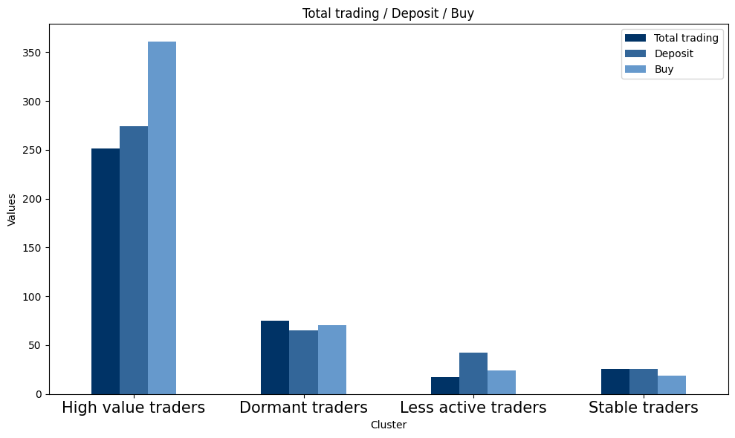
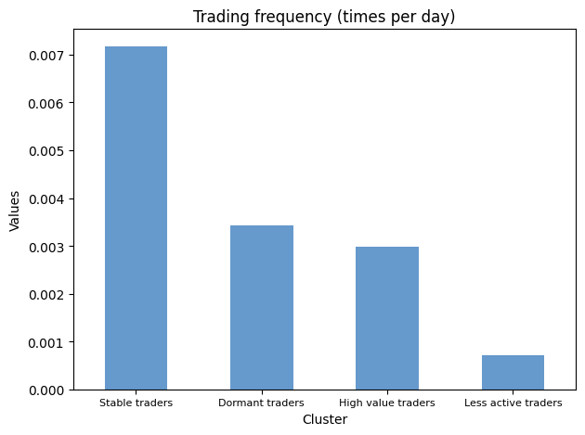
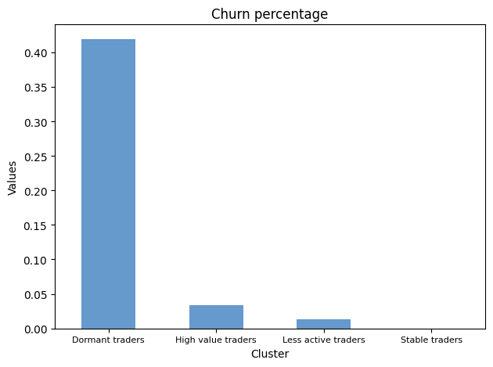
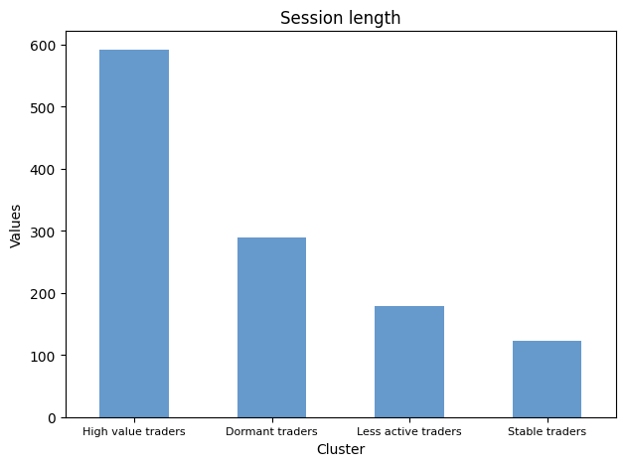
Appendix

Slide 17
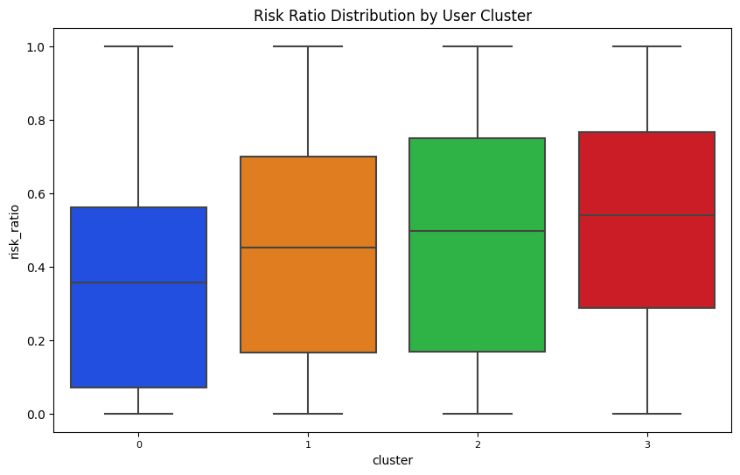
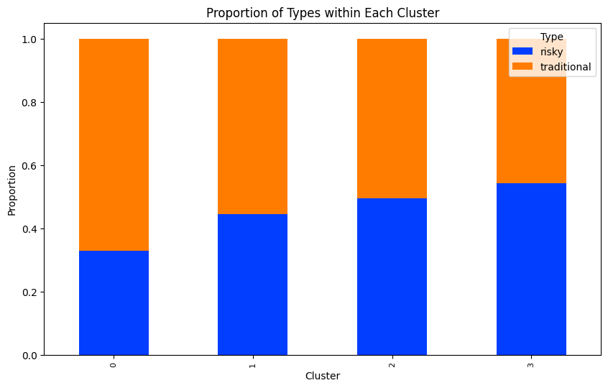
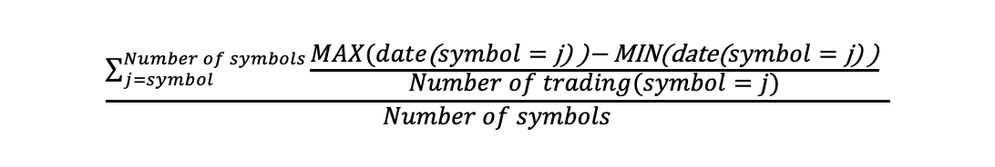
Appendix

Slide 18
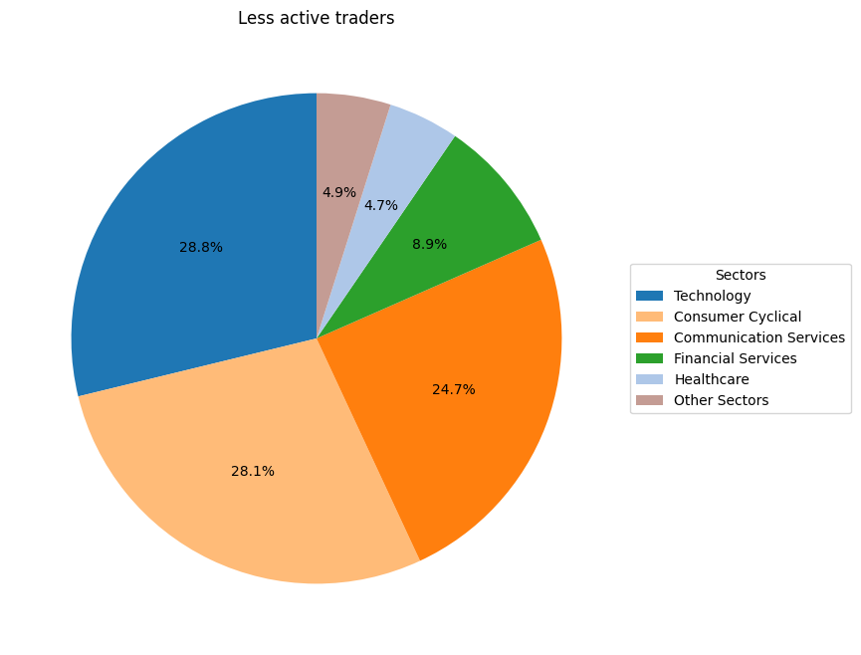
Appendix

Slide 19
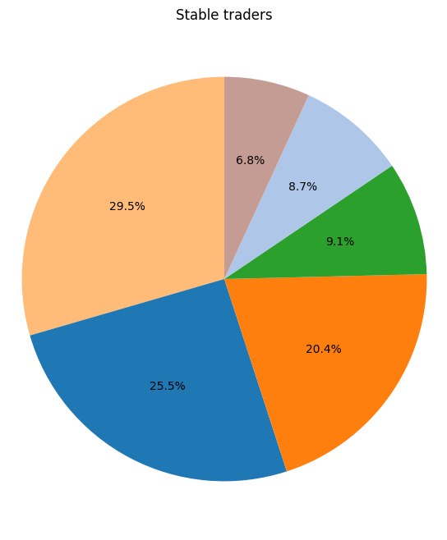
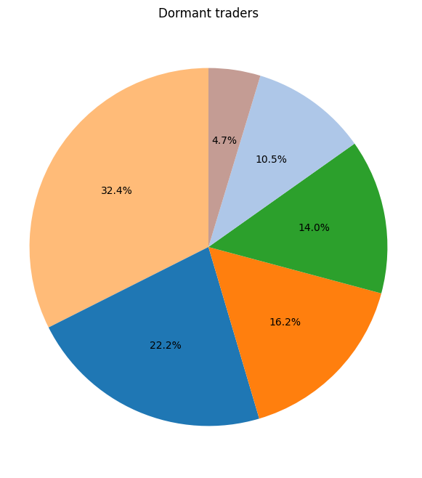
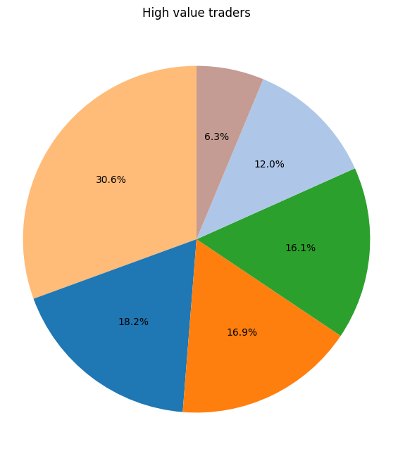
Appendix

